Slide 1
Welcome To Our Presentation
Submitted TO: MD. AYNUL HASAN NAHID Lecturer of CSE Daffodil international university. Submitted by: Rakib Hasan Munna: 151-15-5216 Md. Kamrul Hasan:143-15-4554

Slide 2


Slide 3
Contents
What are live wallpaper?
Android API level
Setting up the Android manifest
Codes
Wallpaper service
Life cycle
Gotchas
Other options

Slide 4
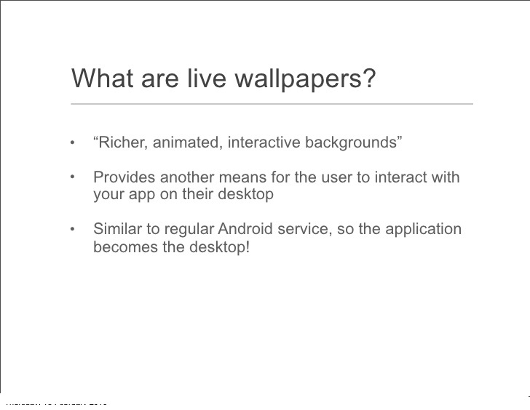

Slide 5
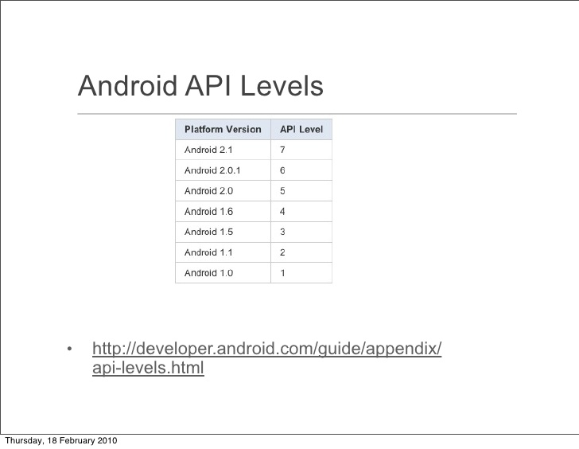

Slide 6
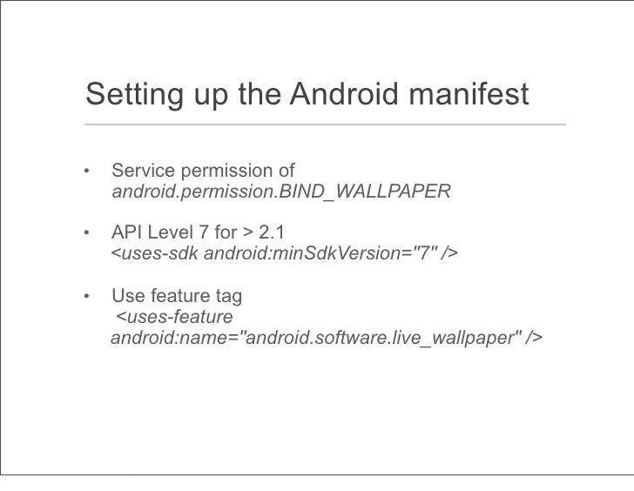

Slide 7
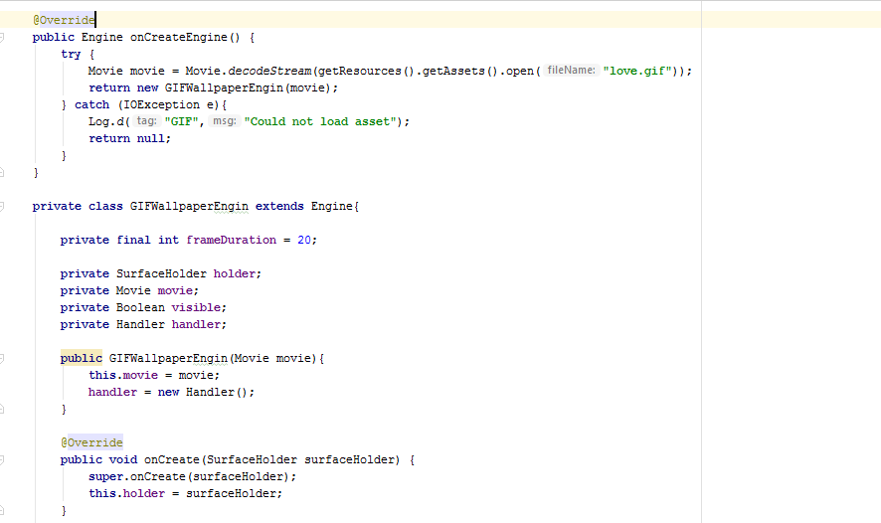

Slide 8
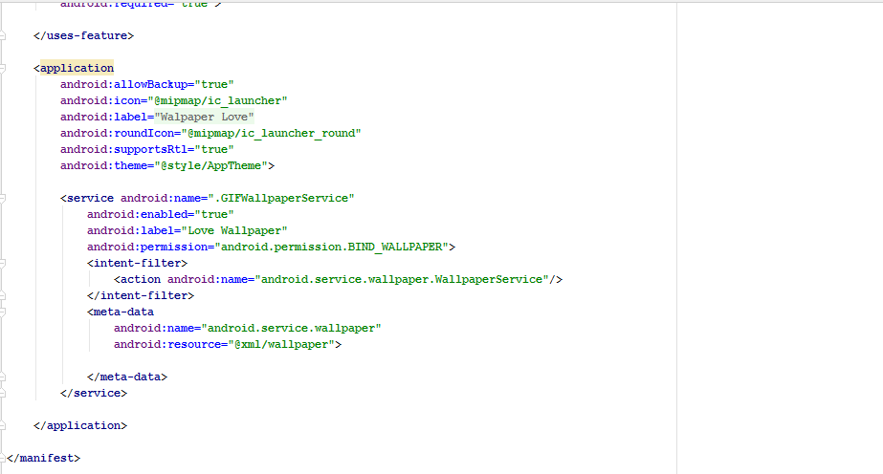

Slide 9
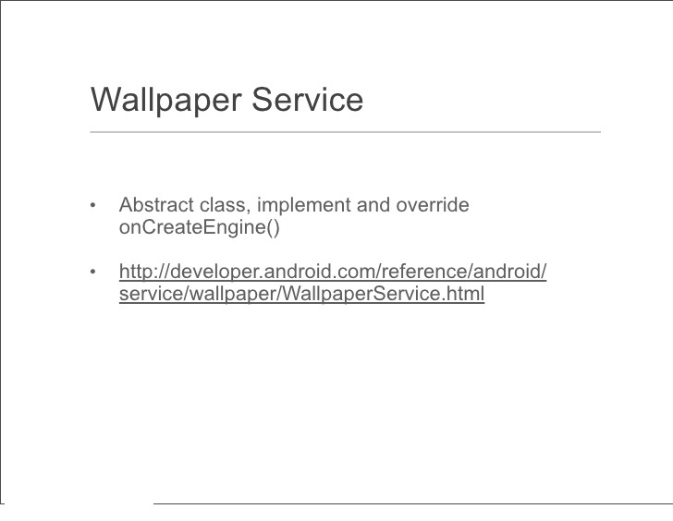

Slide 10
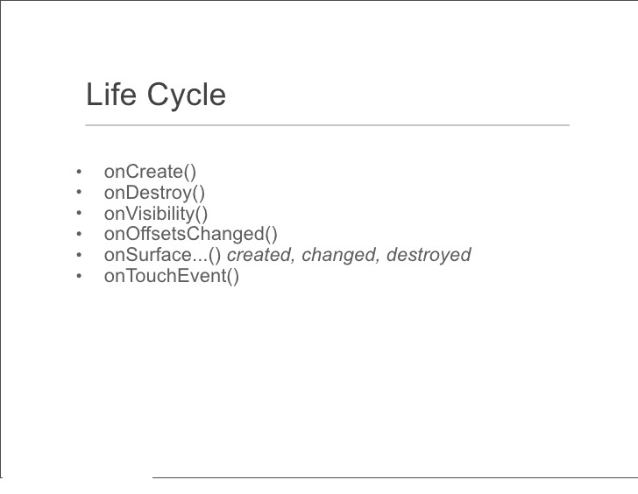

Slide 11
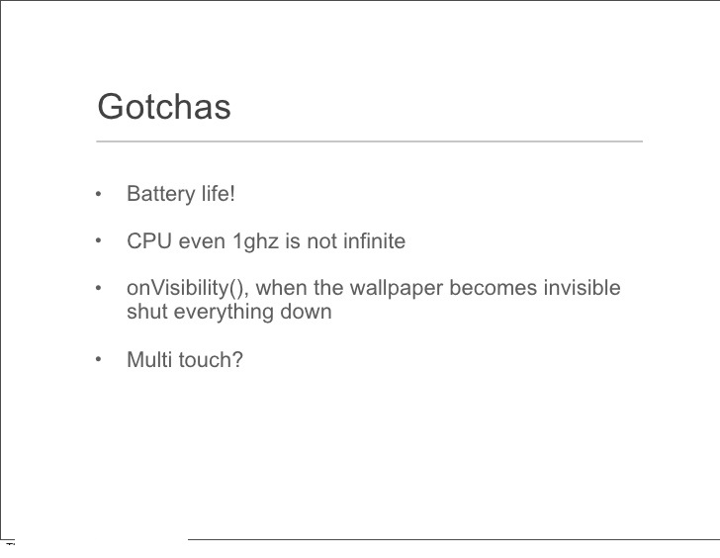

Slide 12
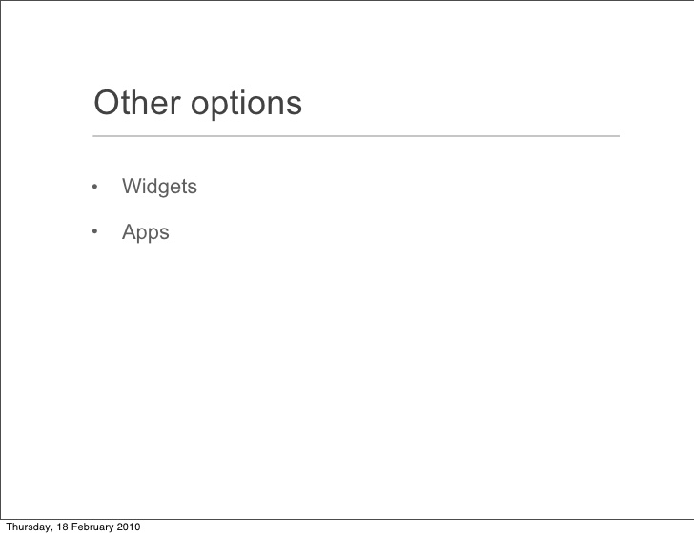

Slide 14


